Slide 1
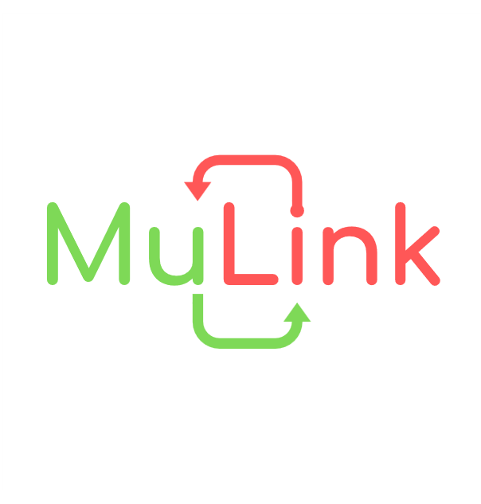


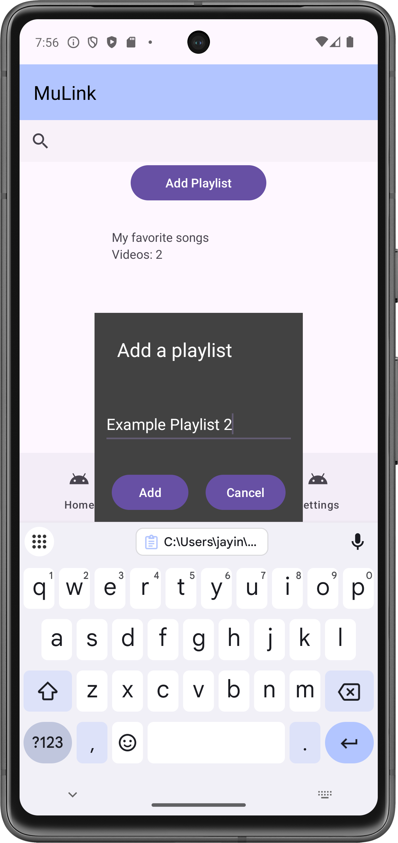
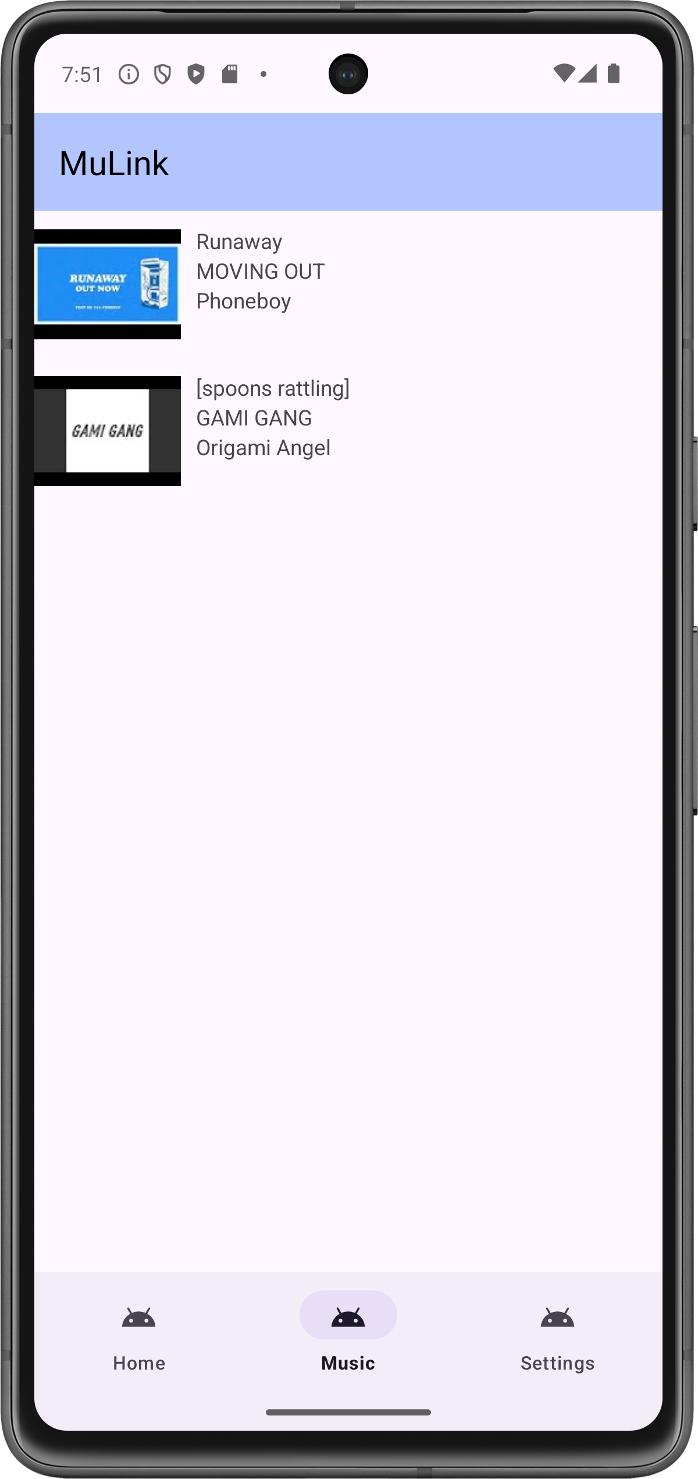
MuLink Justin Joseph, HU, jjoseph4@my.harrisburgu.edu
LOGO
Introduction
System Overview
Architecture: How it works
Current Progress
Planned Supported Services
Spotify
YouTube
SoundCloud
Excessive planning has caused delays in implementation
App has a playlist structure but very little functionality
Currently working on a way to save playlist data to a JSON file.
MuLink is an Android application designed to connect different music streaming services by allowing users to create playlists with songs across connected platforms. MuLink was created to address the problem of some songs being limited to certain platforms and not others, forcing users to traverse multiple services to listen to certain songs and the inability to create playlists containing desired songs.
MuLink is being developed for Android 14.0+ (UpsideDownCake) and newer on Android Studio using Java. It can be installed as an APK file.
MuLink utilizes developer APIs from the services to fetch song details upon user request. These details will be saved when added to a playlist. Eligible songs in playlists can also be used to create playlists on the platforms if requested by the user.
While this app is planned to support Spotify, YouTube, and SoundCloud, support for other services can be implemented in the future. Services of note include Apple Music and Tidal.
Playlists will include a form of redirect that allows users to listen to music, albeit through redirects due to terms and conditions.
*Due to issues with SoundCloud’s API, it will likely not be implemented in the demo version.
Fig. 3: Repository QR Code
Acknowledgements
Thanks to Professor Grim for advising my project.
Fig. 1: Music Menu
Fig. 2: Inside Playlist

